Slide 1
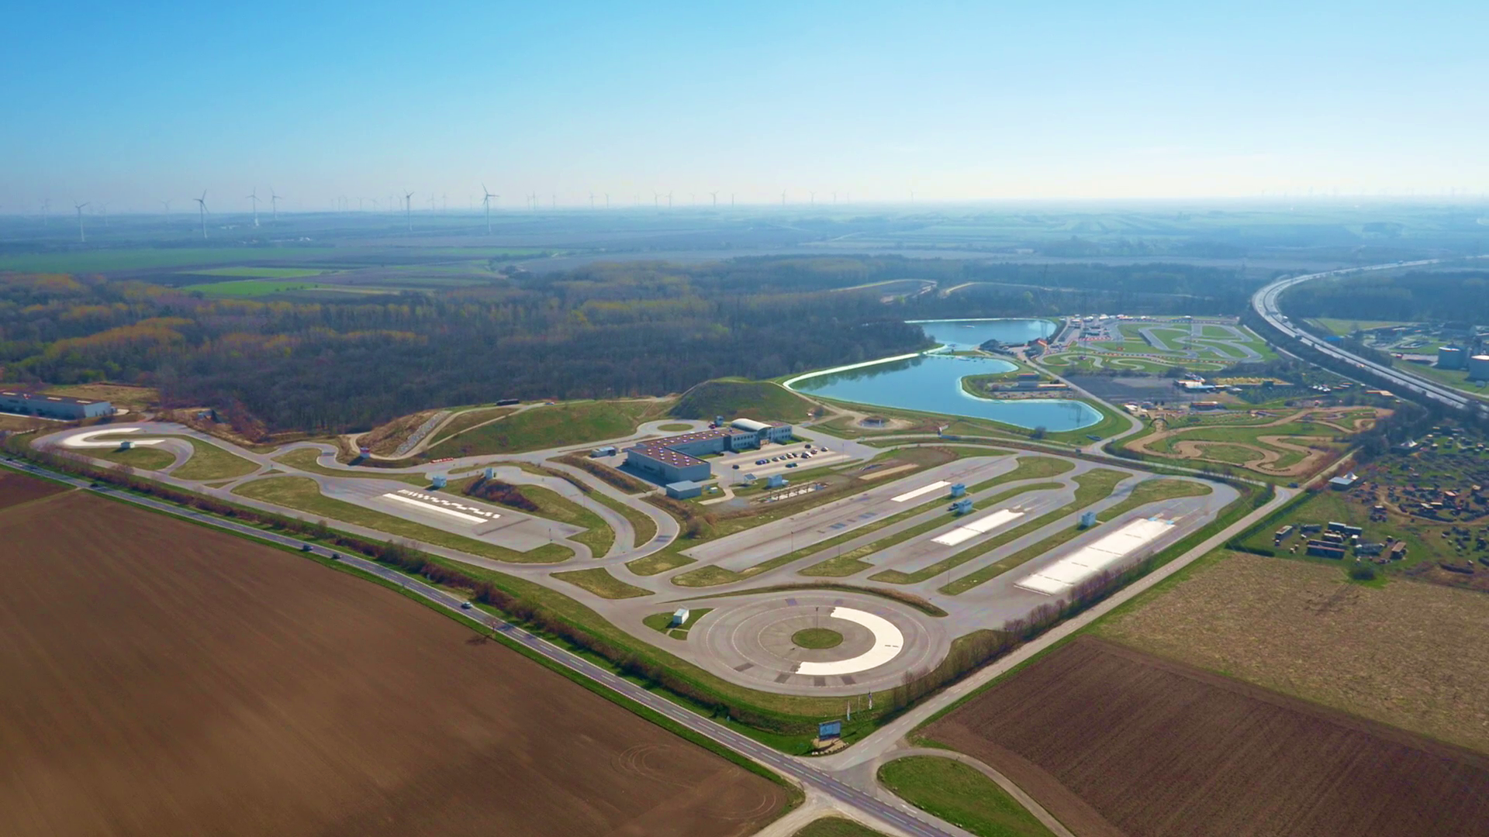

Welcome at
Driving Camp Pachfurth!

Slide 2
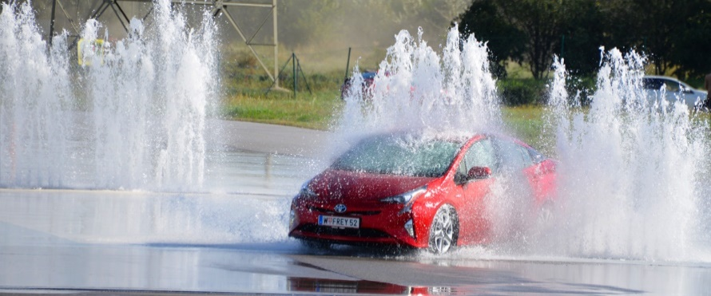
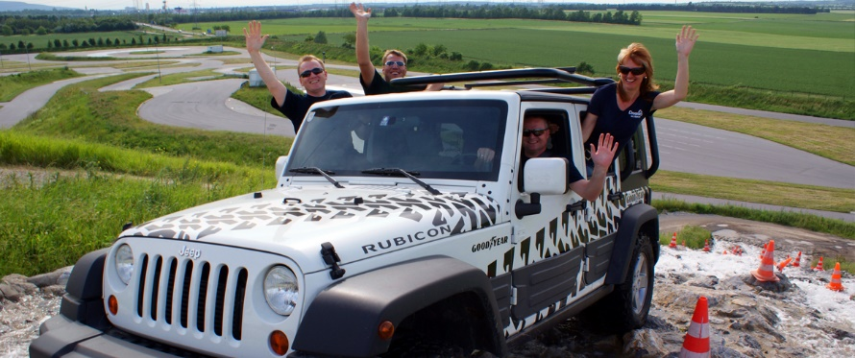
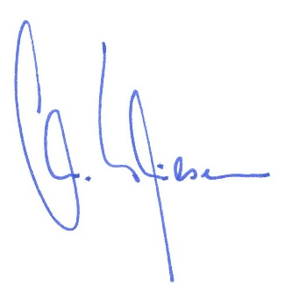
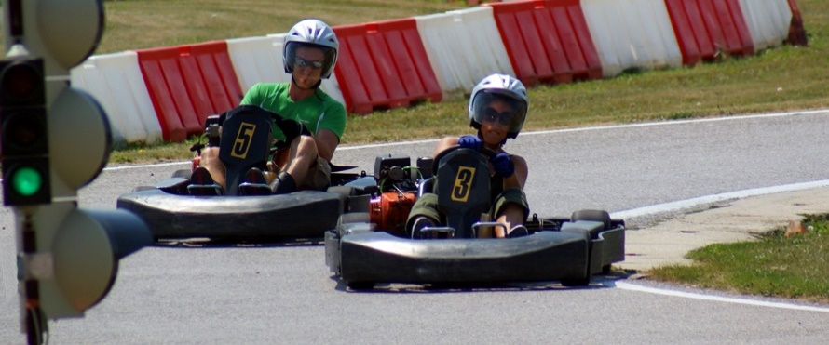

Welcome to the Driving Camp Pachfurth!
Our event location in a nutshell:
Manifold, emotional, multifunctional, professional und full of experiences!
Between the "Twin Cities" Vienna and Bratislava the technically most advanced and one of the largest driving safety centers in Europe is waiting for you.
After more than 15 years in the business we offer this core services:
Training for beginners and experts on cars, motorcycles and trucks
Events like adventures with off roaders, go-karts, quads and jet-ski
Product staging and presentations for all industrial sectors
The promised emotions can be only experienced during a personal visit
at our Driving Camp, to which we sincerely would like to invite you!
Christian Thiesen Marco Kessler
General Manager General Manager

Slide 3
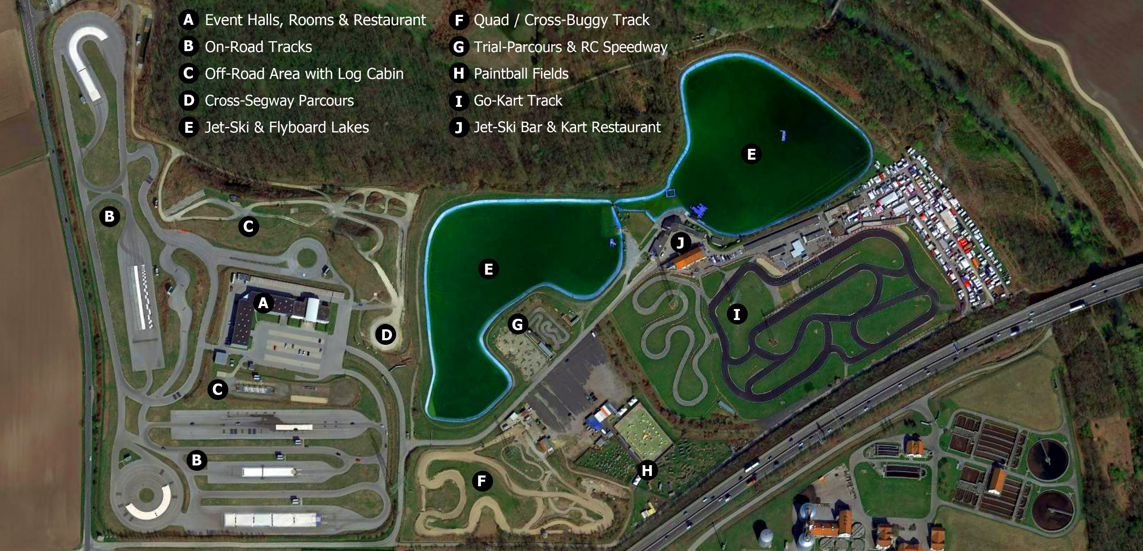


Slide 4
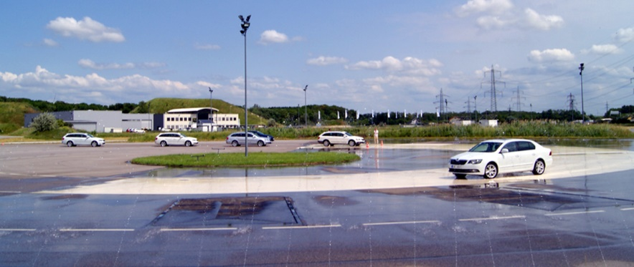
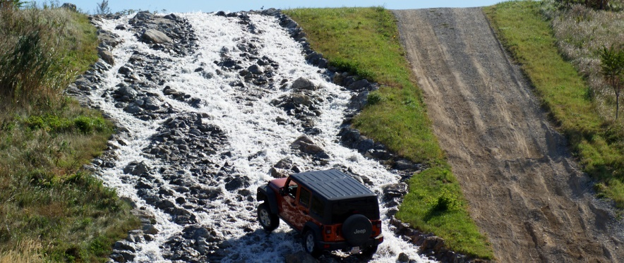
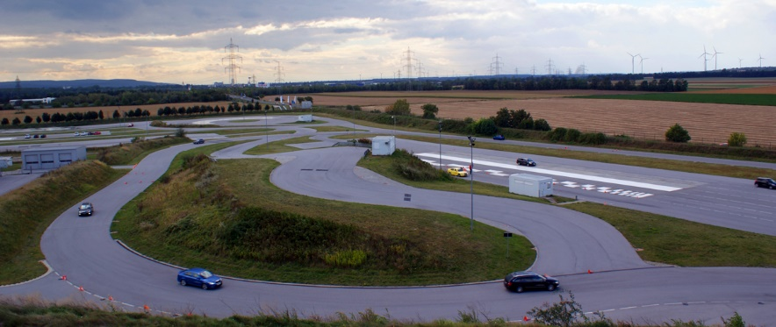
Are we allowed to show off? The Driving Camp Pachfurth.
The eight on-road modules are full of latest technology. With slide-machines, water obstacles, bump roads and low-friction surfaces. For cars, motorcycles, trucks, busses and small transporters.
At our spectacular off-road area you can even find more highlights.
With steep grade, adjustable wade basin, stone stairs, cross inclined hill, waterfall and a lodge with a nice view. For training, adventure and experience.
The 1km long wethandling track offers real motor sport feeling.
With challenging curve combinations and cross-aquaplaning. For comparable driving, perfect line training and drift experience.
Furthermore look on our extras: Eleven training containers, floodlight, car wash and workshops are beside our tracks.
Last but not least: Tracks for go-kart, quads and segways, plus a jet-ski-lake!

Slide 5
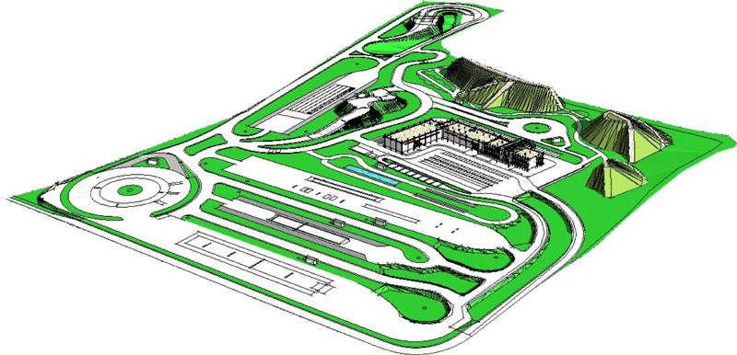
1
Circle with low-friction surface & bump road
Truck slide-machine with low-friction surface
Off-Road wadebasin with traction section
Car slide-machine with low-friction surface
Multifunction area with straight aquaplaning
Downhill-grade with curve (7%)
Motorcycle area with slide-machine
Off-Road area with artificial waterfall
Braking track with five different surfaces
Entrance hall, event halls, seminar rooms
Service box & car wash
Incline course with curves (12%)
(Wet-)Handling track with cross-aquaplaning
2
6
3
4
13
5
6
13
8
7
9
12
7
10
13
11
1
3
5
4
400 meters
2
8
9
320 meters
10
11
12
13

Slide 6
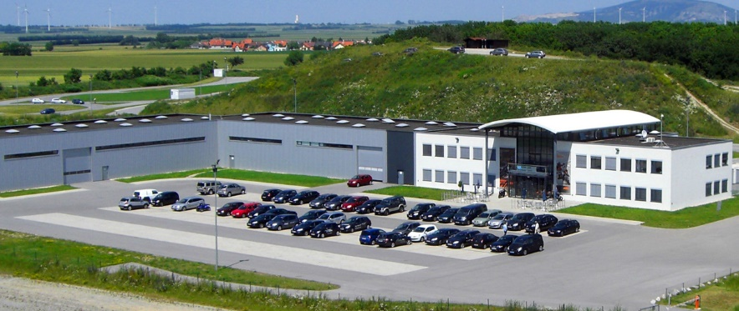
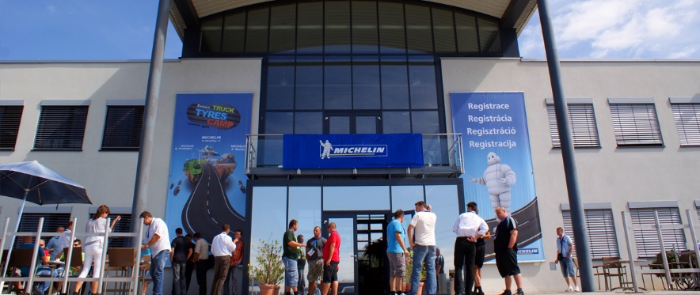
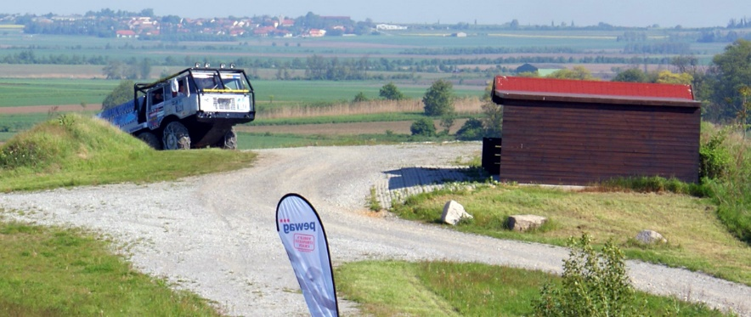
Our halls. Our rooms. Our extras.
More than 1.500m² area for events of all kind, spread over three halls.
You need not take them all. But you certainly could!
The high quality and multi-flexible building invites your guests to product presentations, trainings or celebrations. Beside our eventful outdoor area. Plus our in-house gastronomy.
More interesting facts for you:
Entrance hall (250m²)
Two further halls (400 and 750m²) both independent and fit for vehicles
Five seminar rooms (40 - 80m²)
An office with reception desk for registration in case of longer events
Different back offices (15 - 50m²)
Separate service box for car service (70m²) and car wash
Log cabin at the off-road area (for more than 50 people)
Four advertising banners on main building and billboards on the tracks

Slide 7
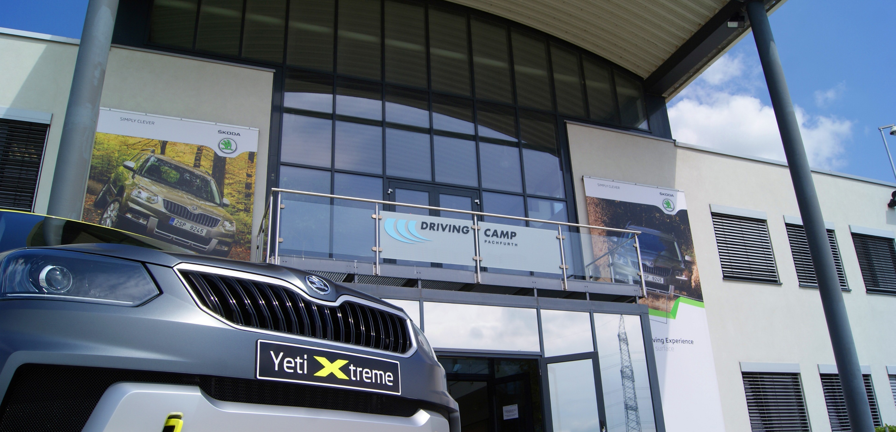

Slide 8
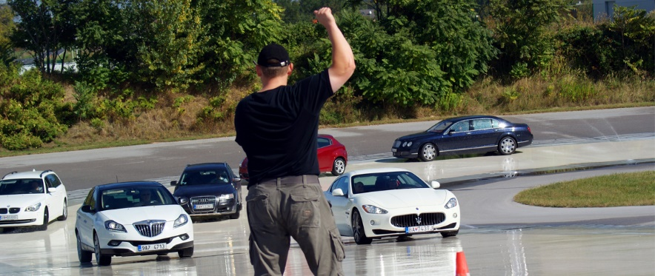
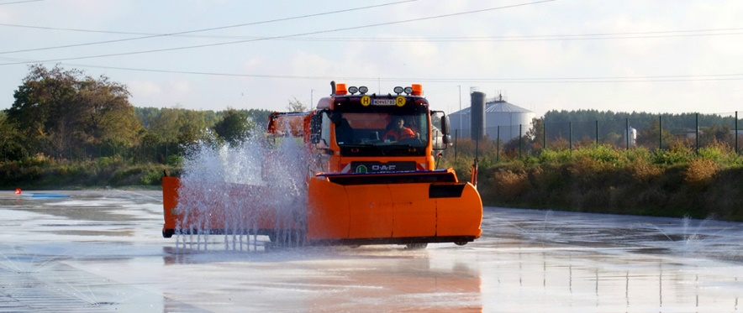
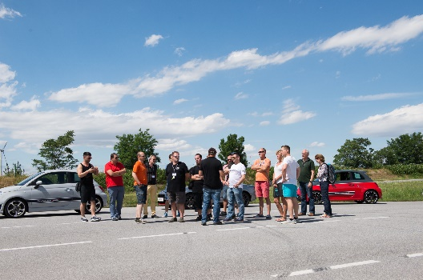
Driver training? Thats our business. For sure.
Our experienced instructors introduce you to all kind of exercises. No matter if you are young, old, female, male, beginner or expert.
At Driving Camp Pachfurth we offer everyone his or her specific training.
Our classical safety training:
Car- and motorcycle intensive training
Advanced training for high und highest demands
Courses and coachings with individual content
Training for professional utility vehicle drivers
For special demands we offer:
Trainings combined with company specific contents
Seminars for economic and defensive driving
Off-road training

Slide 9
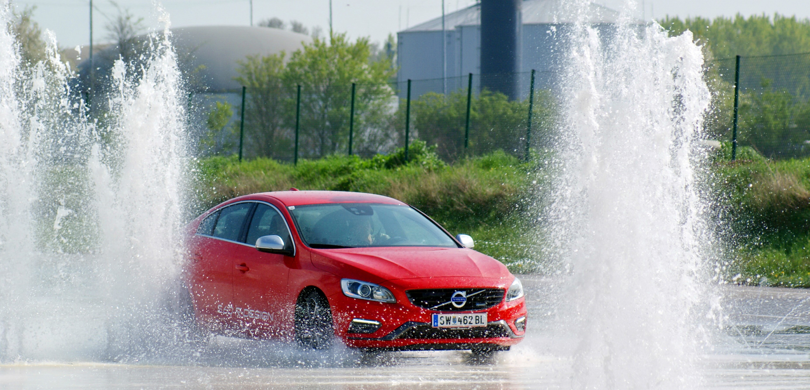

Slide 10
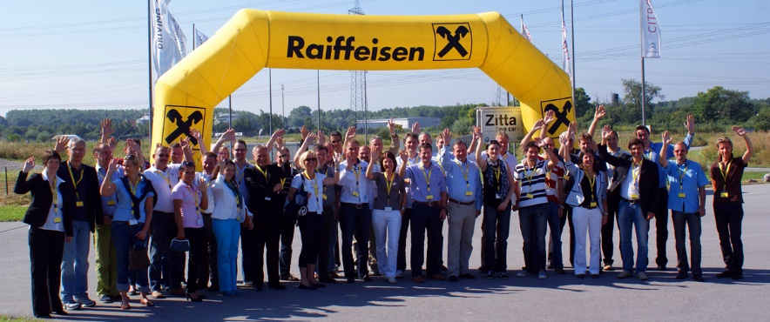
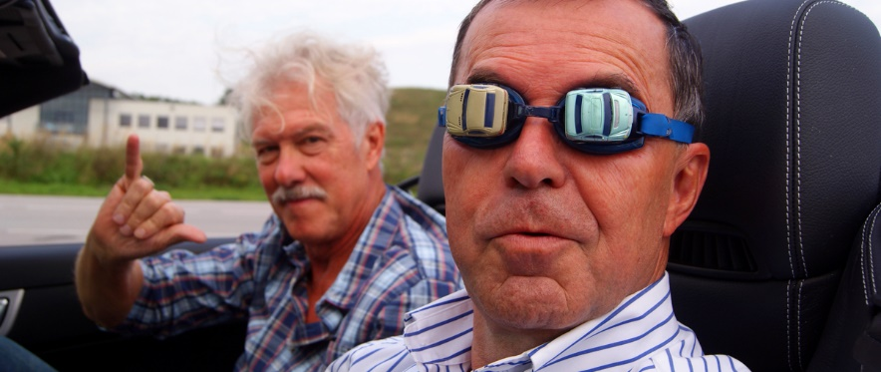
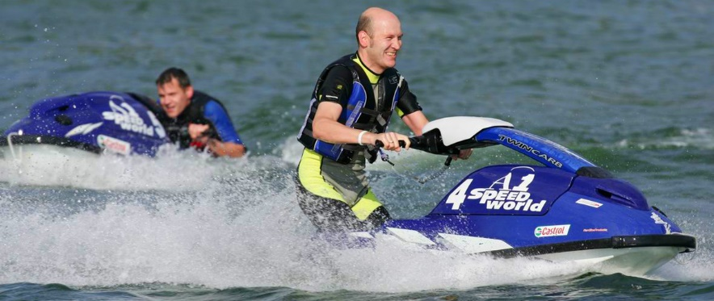
We can do it the different way. Really different!
In addition to the existing training programmes we offer you a whole lot
of more excitement and adventure – for sure very creative alternatives:
Adrenaline & Thrill?!
Off-road adventure in extreme topography
Drift training on our big circle track
Sports car driving on the circuit
Competition & Team-Events?!
Car ability tournament against the clock
Classical go-kart race against the colleagues
Blindfolded parcours in the off-road against the normal
Fun & Pleasure?!
Quad or buggy race on our gravel track
Cross-Segway fun at the off-road parcours
Jet-ski experience on our lake

Slide 11
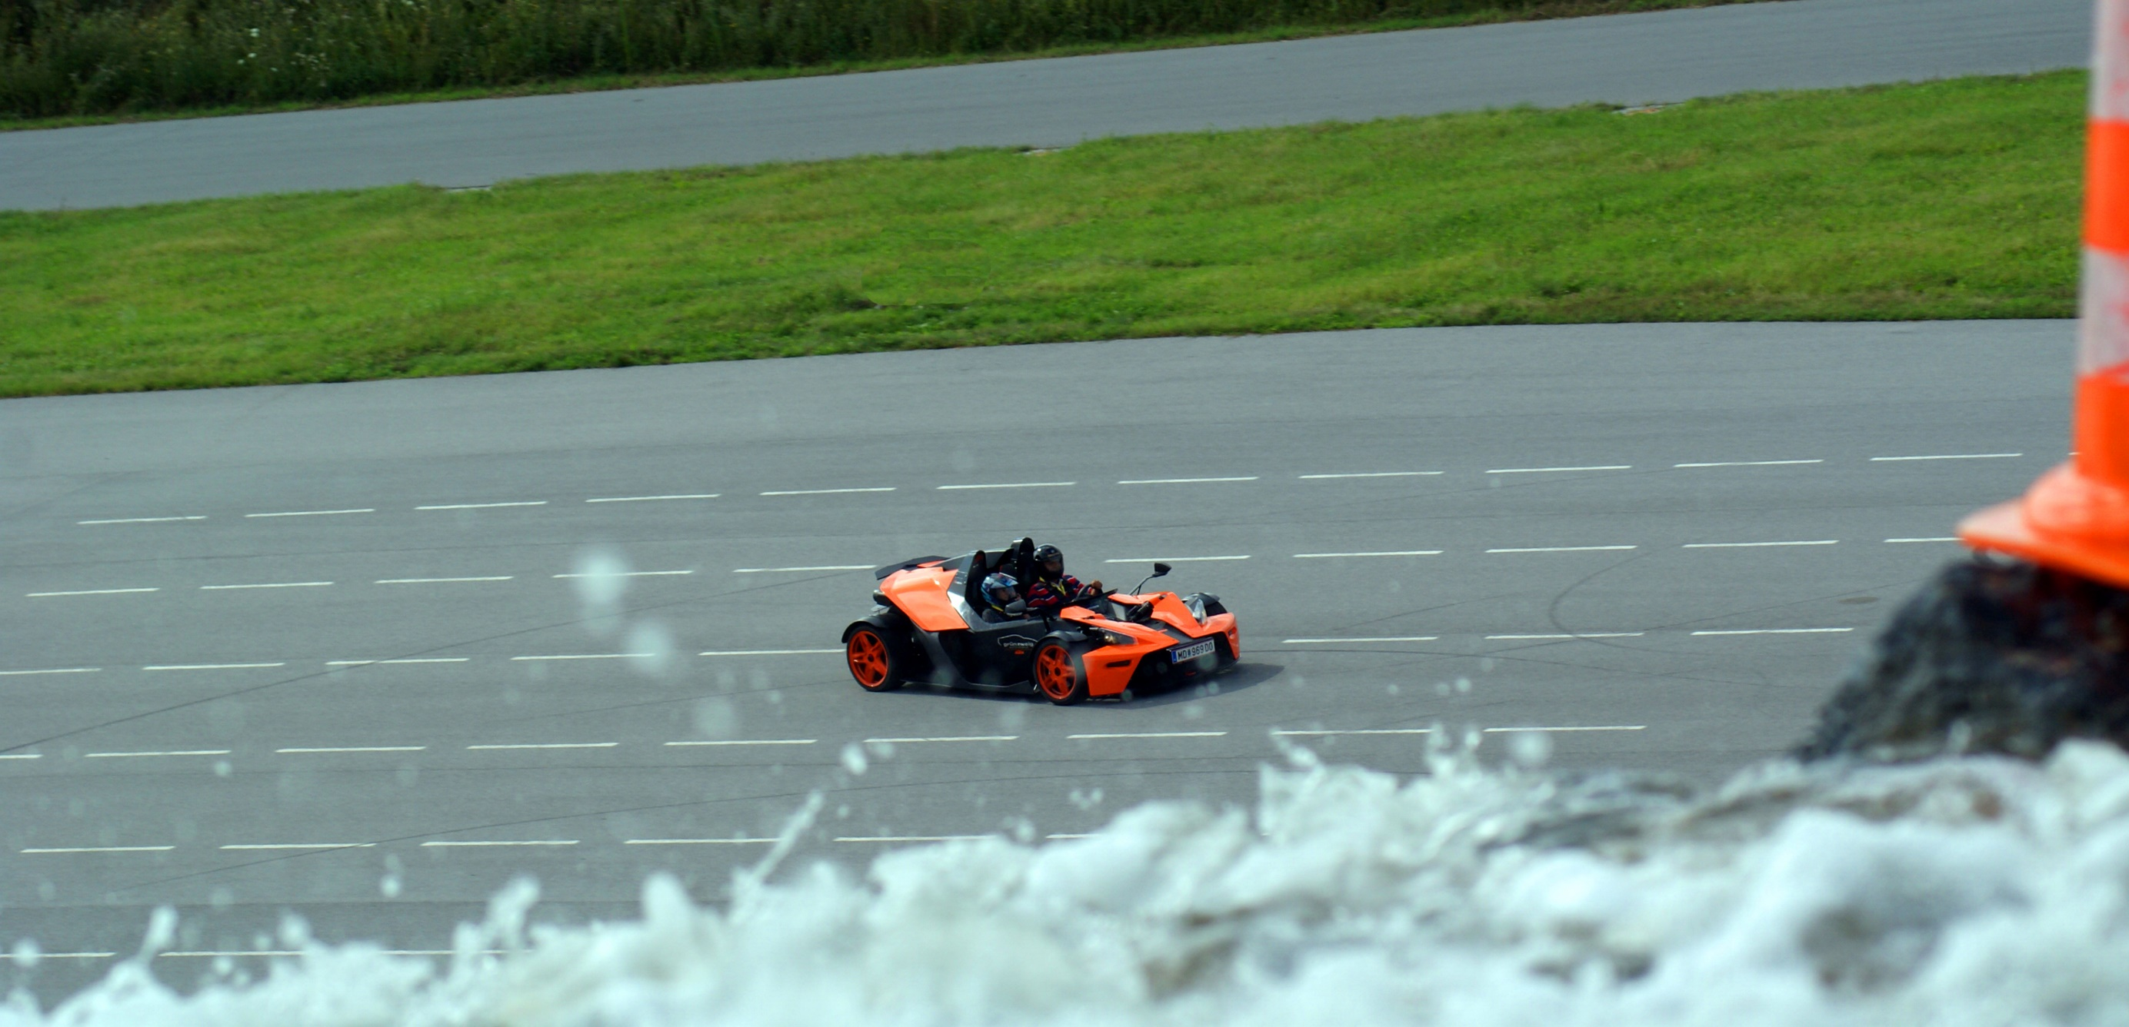

Slide 12
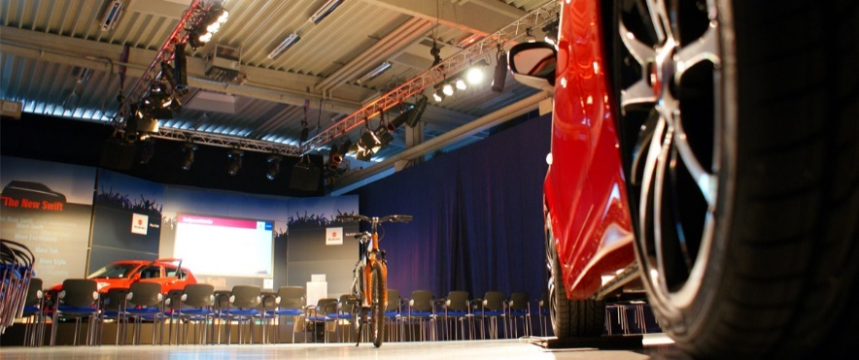
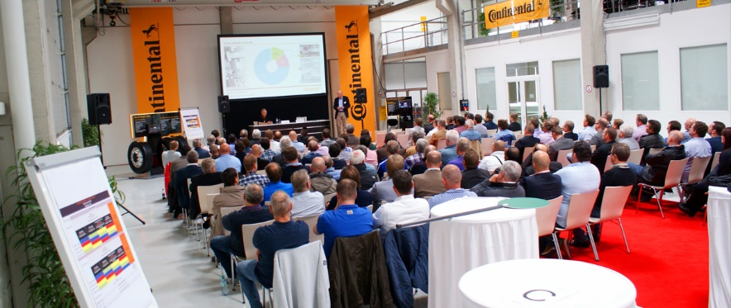
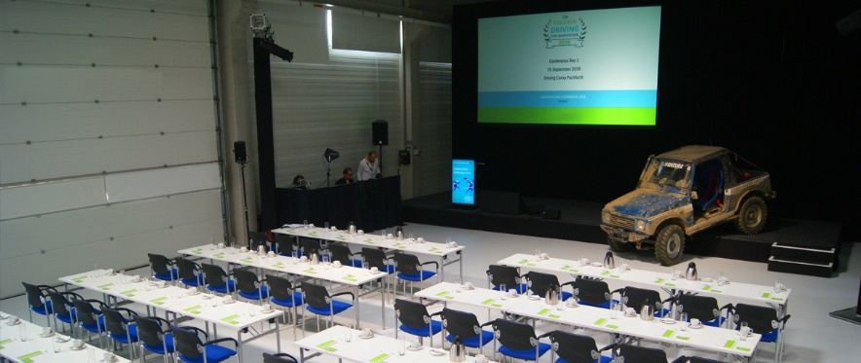
Yes, we can serious, too. With presenting and staging!
Present …
your new product at the Driving Camp if you need something like that:
A high-tech safety driving facility
A professional building equipped for events
A unique variety for side events
A central site between the EU capitals Vienna & Bratislava
A direct connection to the highway and only 15 minutes from Vienna Airport
Stage …
your brand in Pachfurth if you wish furthermore :
Experienced personnel for events plus extensive support
Professional instructors for vehicles of all kind
Event service provider e.g. for catering, event equipment or car handling
Hotels in all categories in our region
An appealing and lovely region between Lake Neusiedl and Vienna

Slide 13
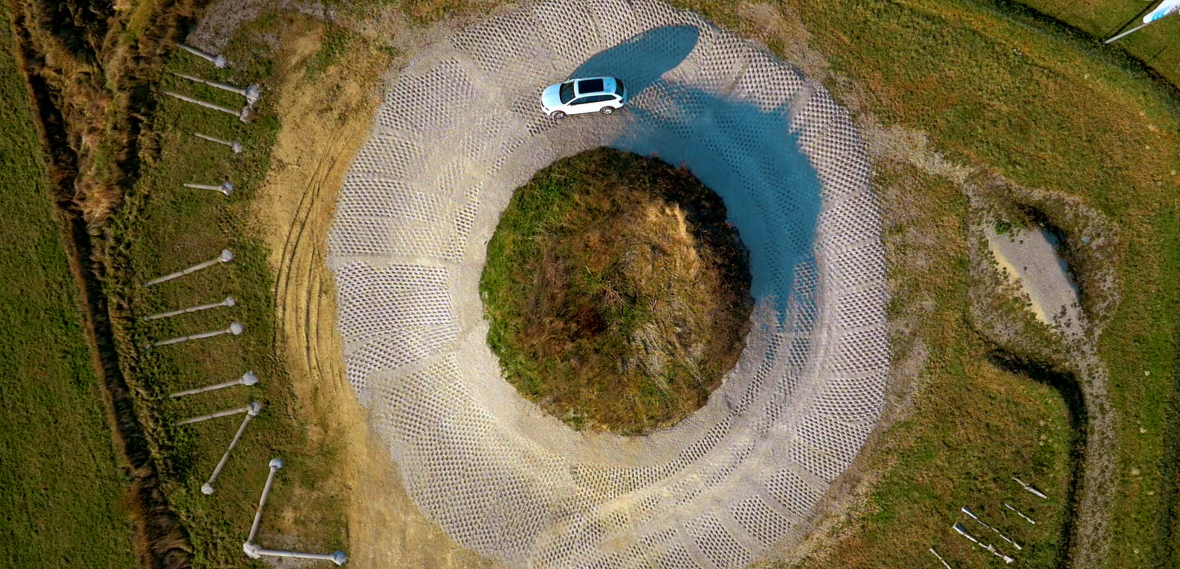

Slide 14
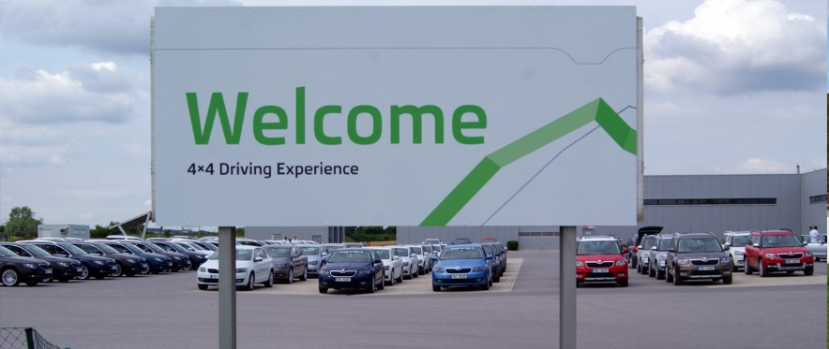
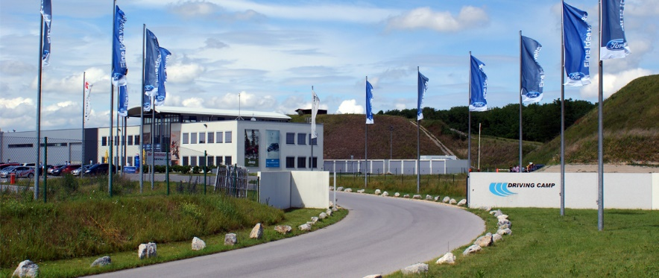
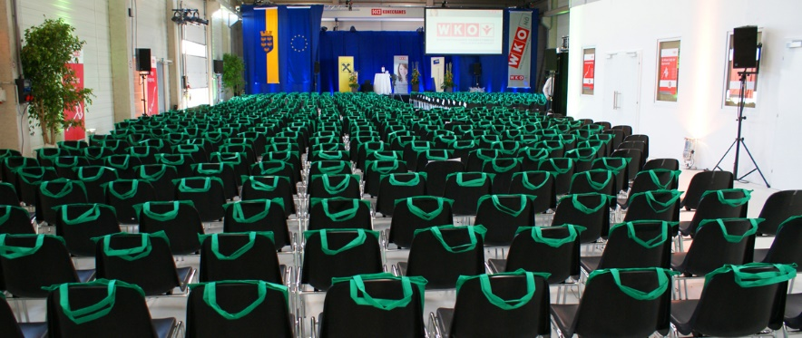
What about a visit? The route is quiet simple …
The Driving Camp Pachfurth is easely to find: From Vienna Airport it is only
15 minutes, from the exit of the highway less than 500 meters.
Do we inspire your interest? So we will see you soon?!
Christian Thiesen Marco Kessler
General Manager General Manager
+43 2164 22 3 77-88 +49 221 66 95 85-19
c.thiesen@drivingcamp.wien m.kessler@drivingcamp.wien
Here you can find us online: www.drivingcamp.wien!
Driving Camp Pachfurth We also have an office in Cologne:
Friends + Experts GmbH Kessler & Thiesen GbR
Freizeitzentrum 2 Martkstraße 33
A-2471 Pachfurth D-50968 Köln

Slide 15
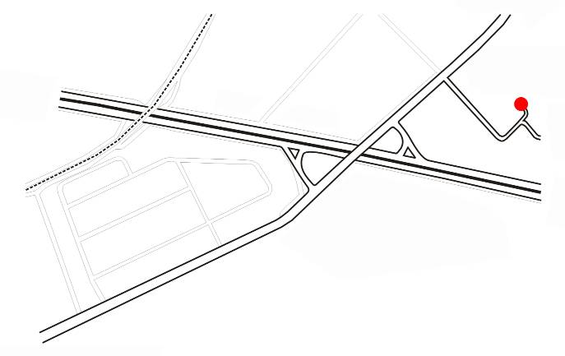
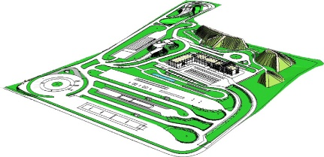
Pachfurth
(2 Minutes)
Airport
(15 Minutes)
Vienna
(25 Minutes)
Motorway A4
Bratislava
(25 Minutes)
Budapest
(120 Minutes)
Exit
Bruck a. d.
Leitha Ost
Bruck a. d. Leitha
(5 Minutes)

