Slide 1
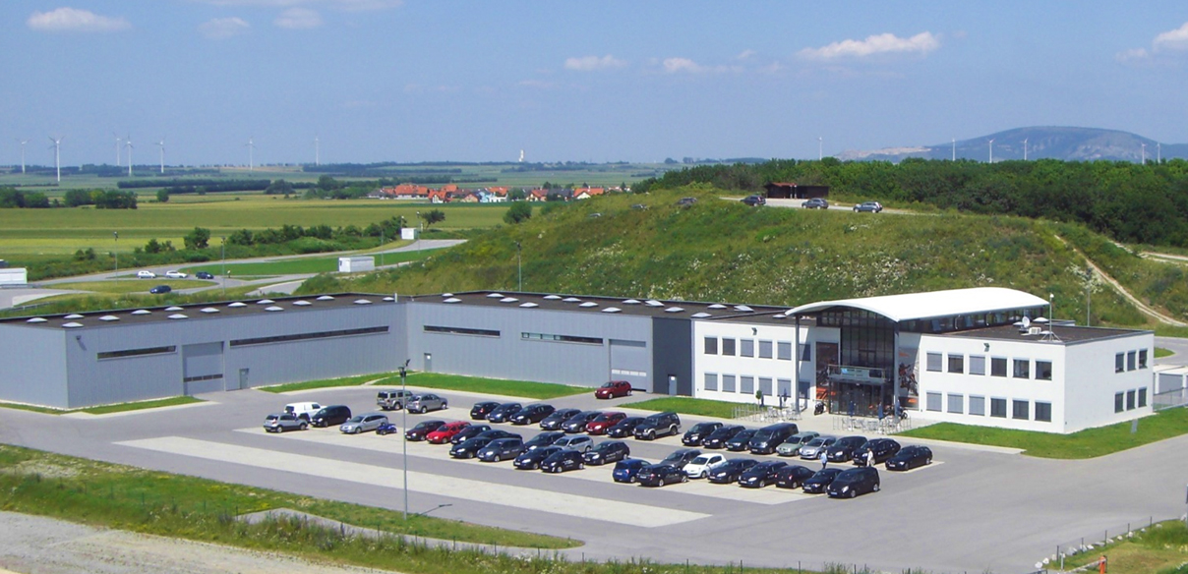

We give your guests
a home!

Slide 2
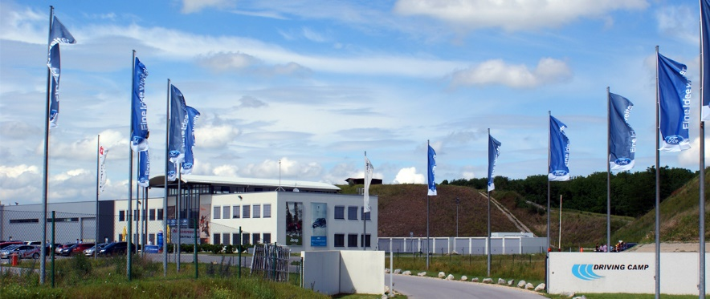
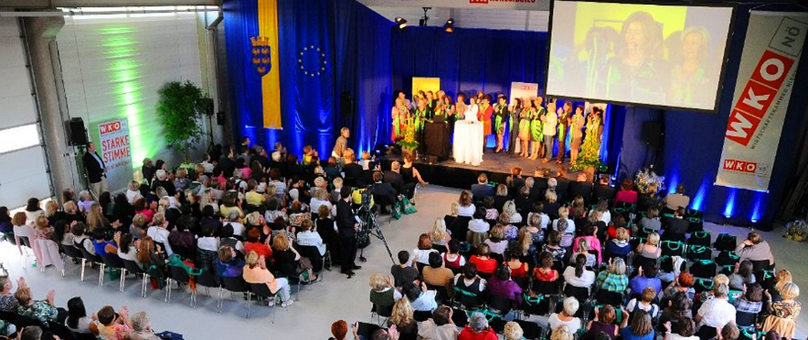
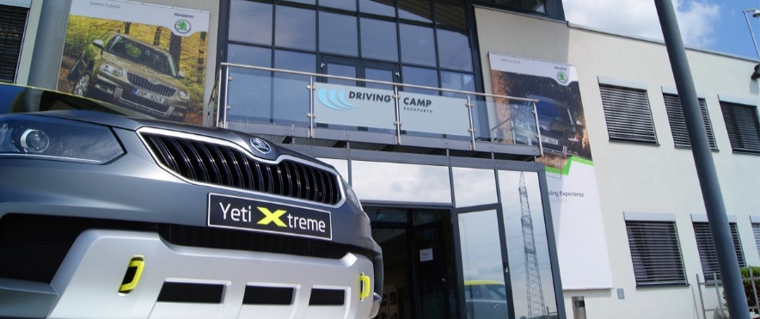
We give your guests a home!
Every event needs something like a "home-base" where the guests find both the startingpoint for the activities and the final destination after an exciting day at the Driving Camp Pachfurth! Our building - high-quality and very much flexible - is perfectly suited for product-presentations, incentives, seminars, in-house-trainings or an event for company-staff. Beside the unique driving-area our building provides the following qualities:
Entrance hall (250m²)
Two further halls (400 and 750m²) both independent and fit for vehicles
Five seminar rooms (40 - 80m²)
An office with reception desk for registration in case of longer events
Different back offices (15 - 50m²)
Separate service box for car service (70m²) and car wash
Log cabin at the off-road area (for more than 50 people)
Four advertising banners on main building and billboards on the tracks

Slide 3
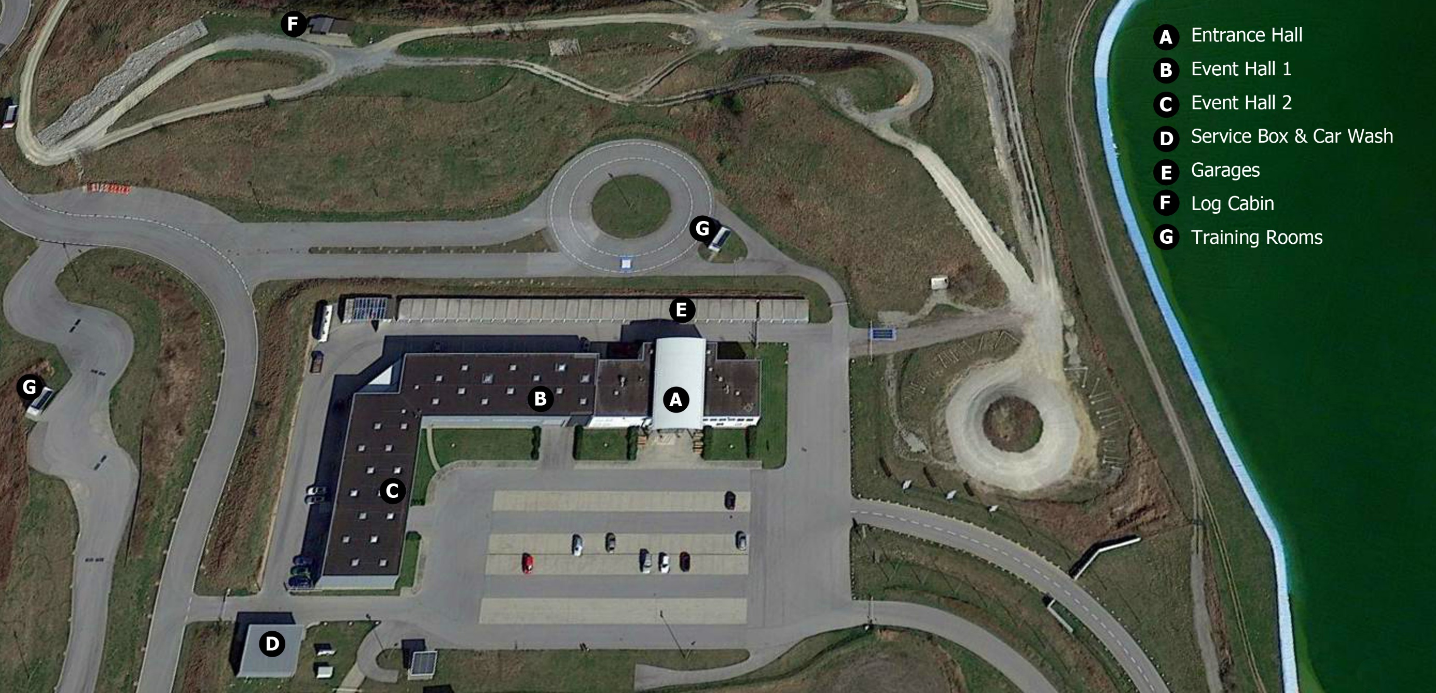

buildings - general overview

Slide 4
main building - ground floor & first floor

Slide 5
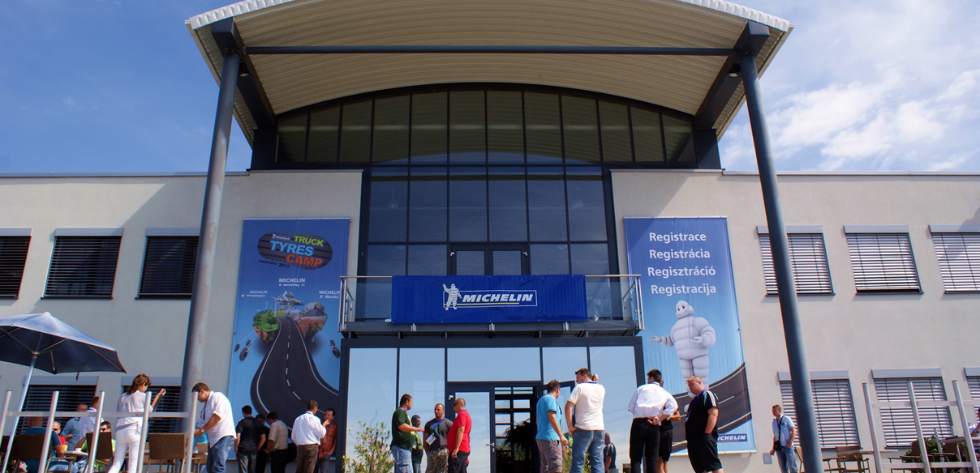
main building - entrance with banner ads

Slide 6
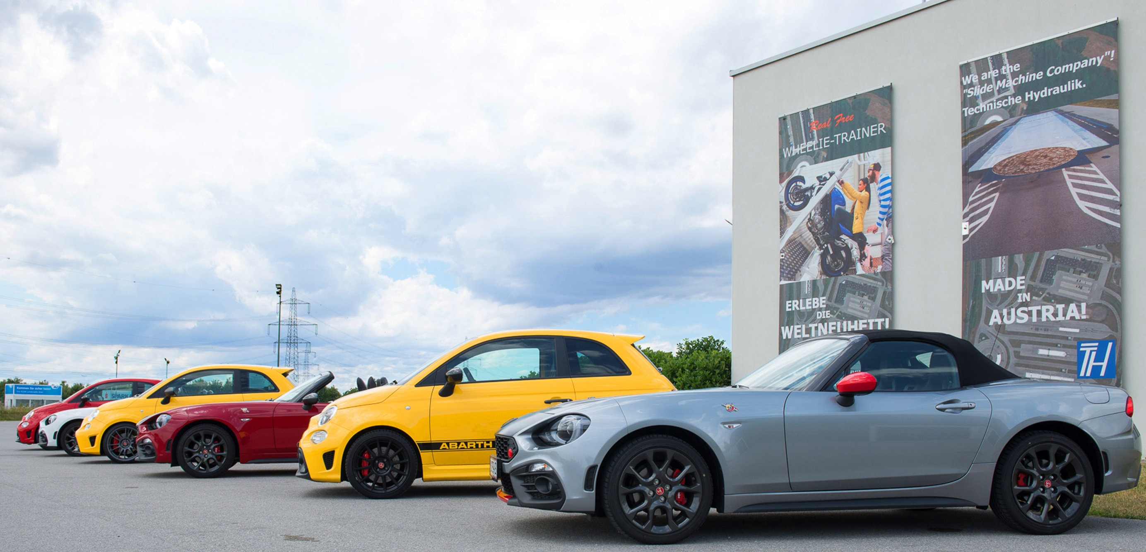
main building - banner ads on the side wall

Slide 7
entrance hall - ground plan of ground floor

Slide 8
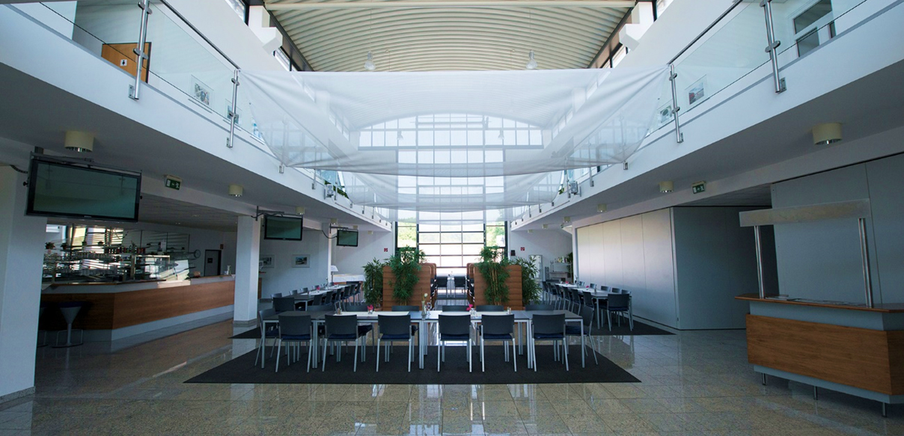
entrance hall - view from entrance

Slide 9
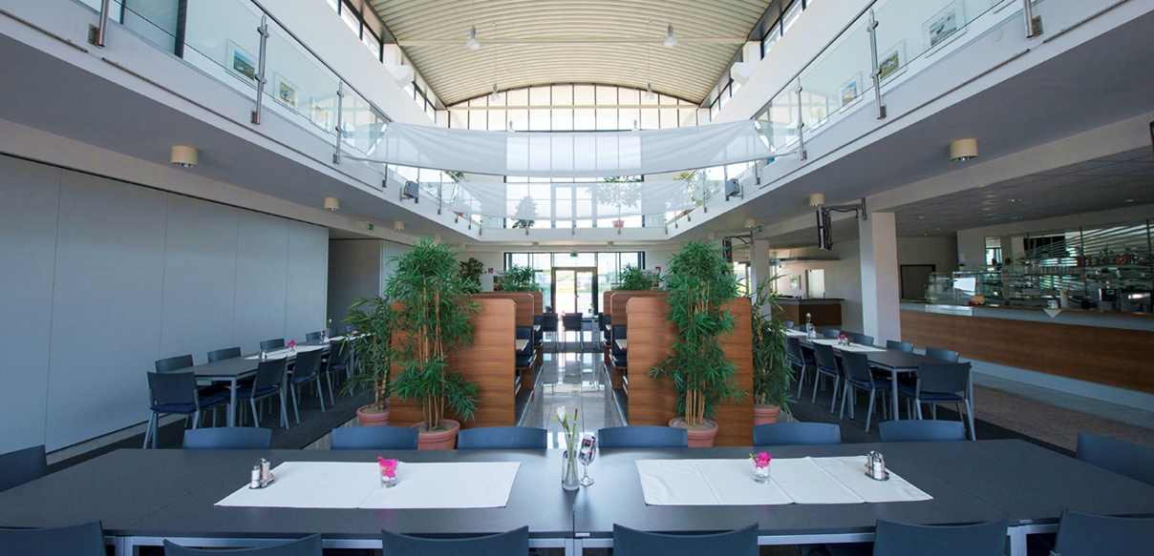
entrance hall - view from back side with entrance, reception and bar

Slide 10
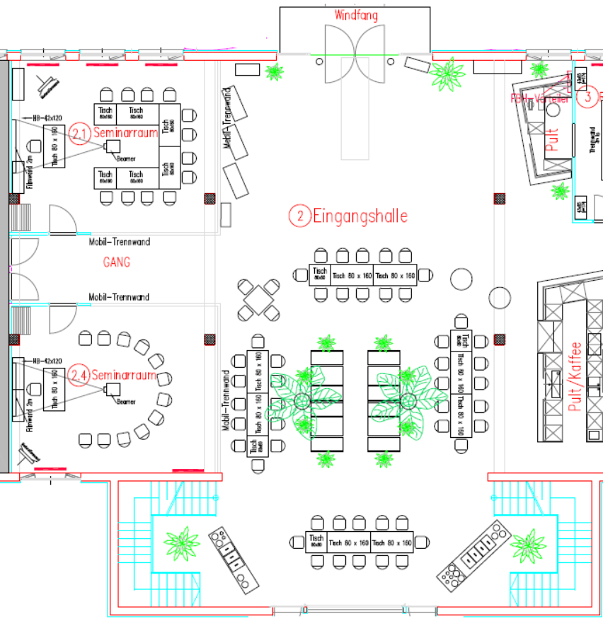
entrance hall - ground plan of seminar rooms

Slide 11
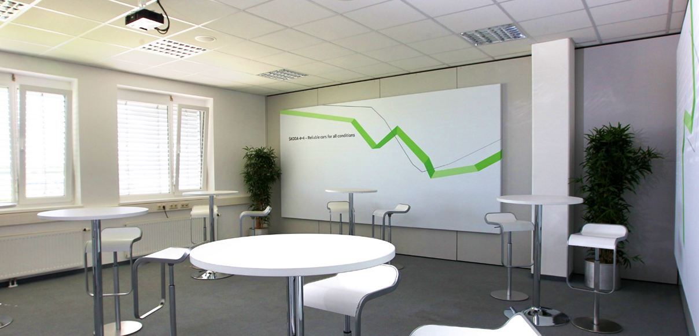
entrance hall - seminar room

Slide 12
event hall 1 - ground plan of ground floor

Slide 13
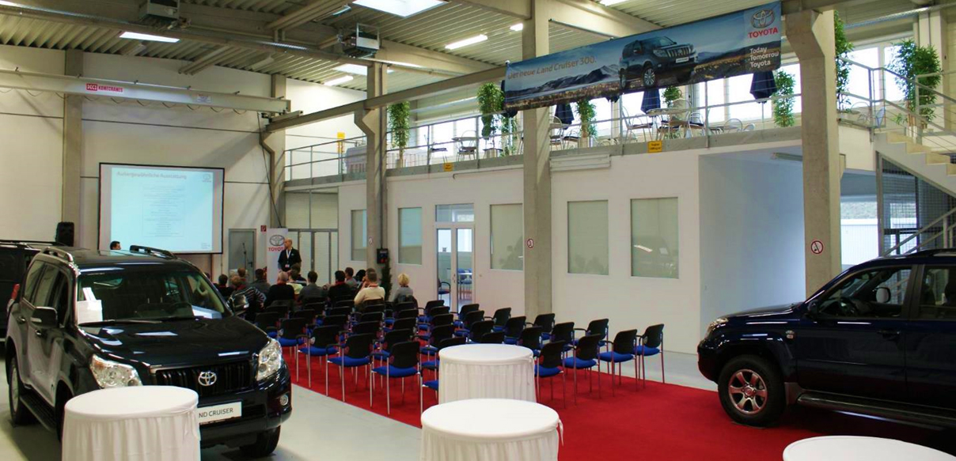
event hall 1 - view on seminar room and arcade

Slide 14
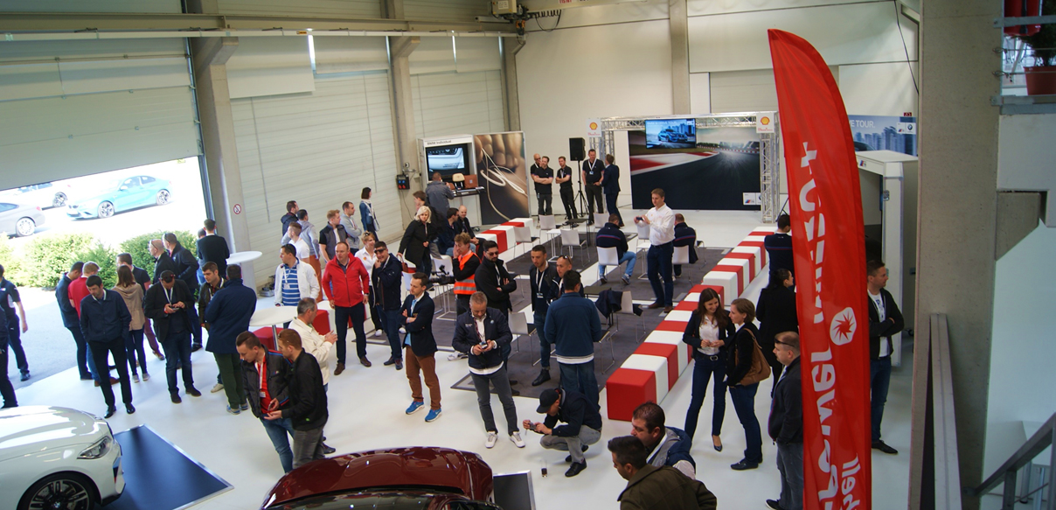
event hall 1 - view on sectional door

Slide 15
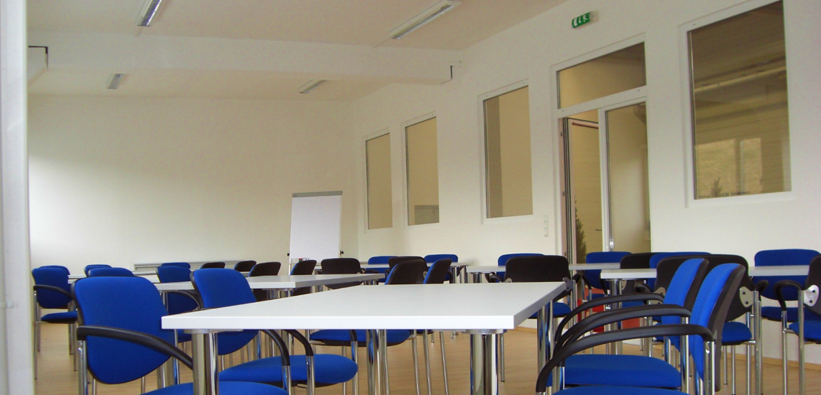
event hall 1 - seminar room

Slide 16
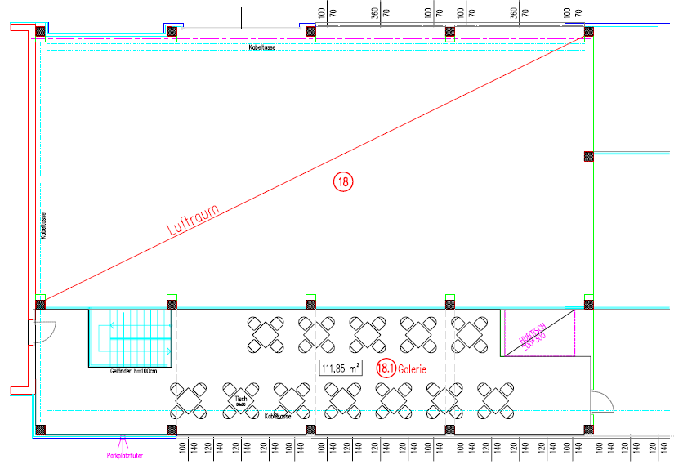
event hall 1 - ground plan of first floor

Slide 17
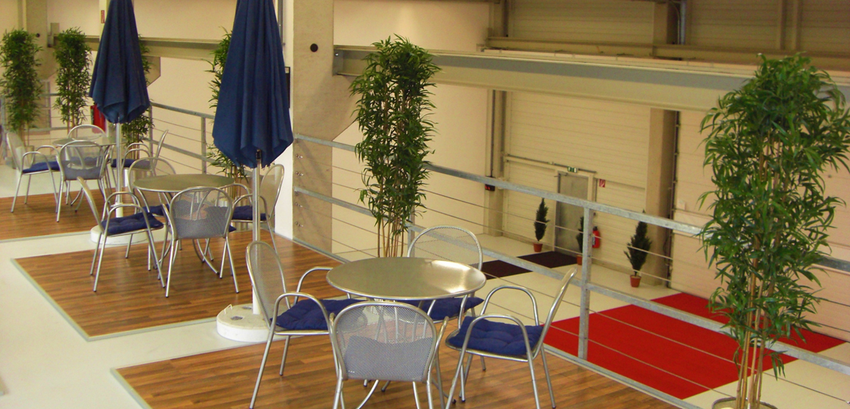
event hall 1 - view from arcade

Slide 18
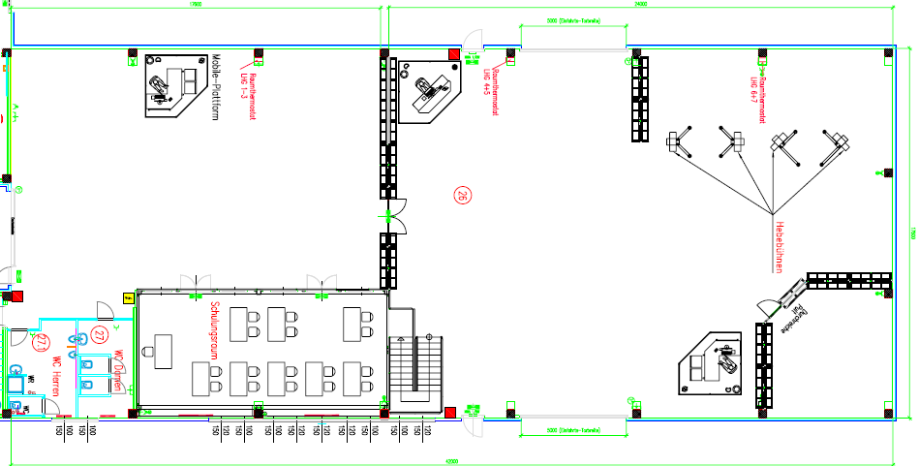
event hall 2 - ground plan of ground floor

Slide 19
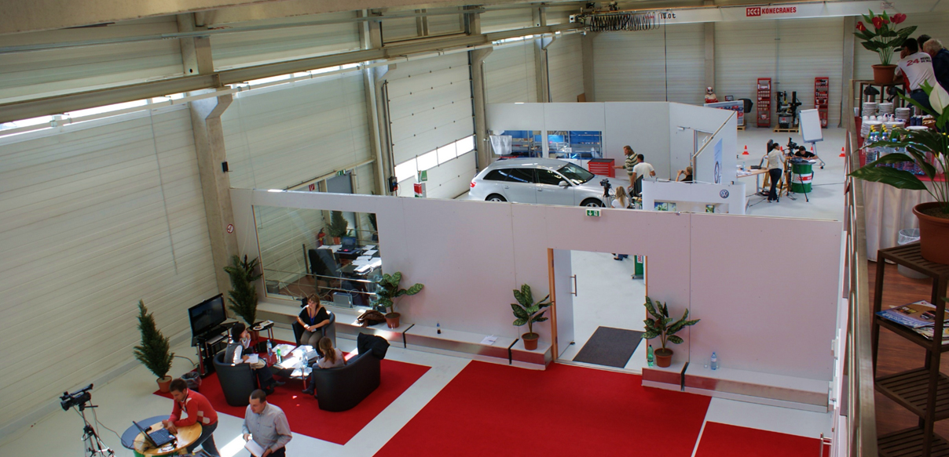
event hall 2 - view from arcade on mobile walls and one of three sectional doors

Slide 20
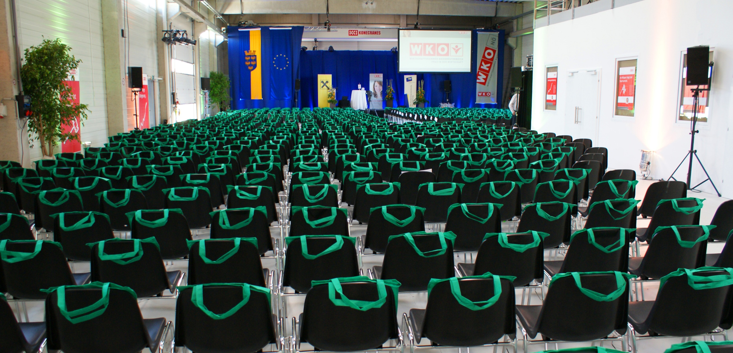
event hall 2 - view on seminar room (right)

Slide 21
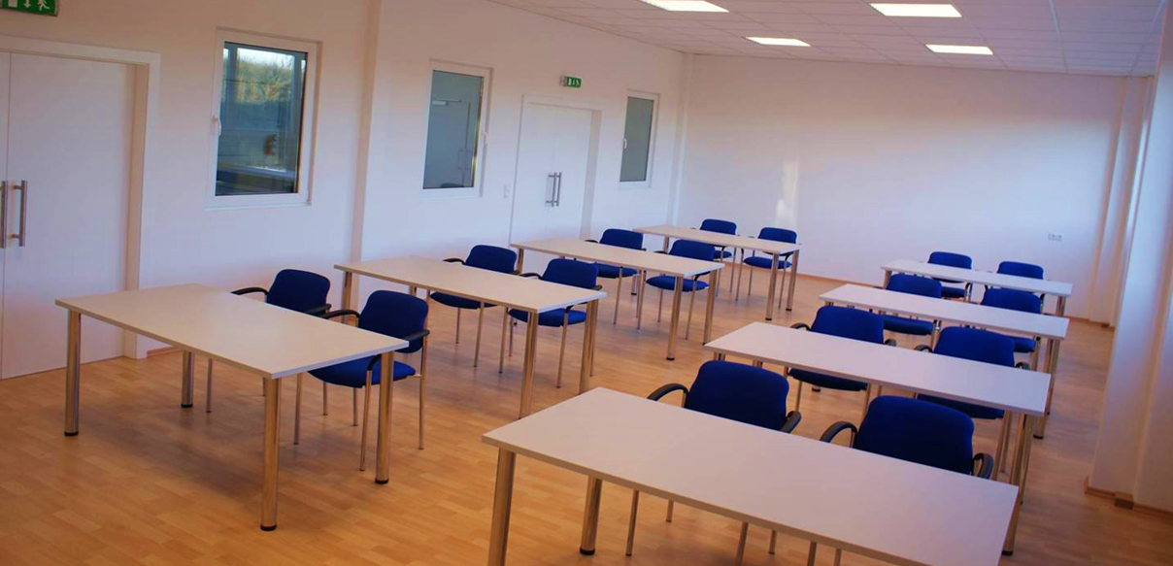
event hall 2 - seminar room

Slide 22
event hall 2 - ground plan of first floor

Slide 23
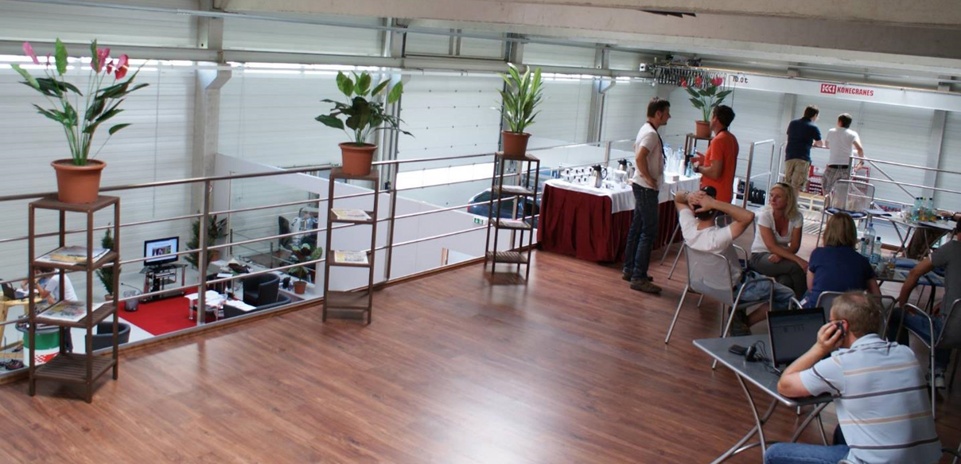
event hall 2 - arcade

Slide 24
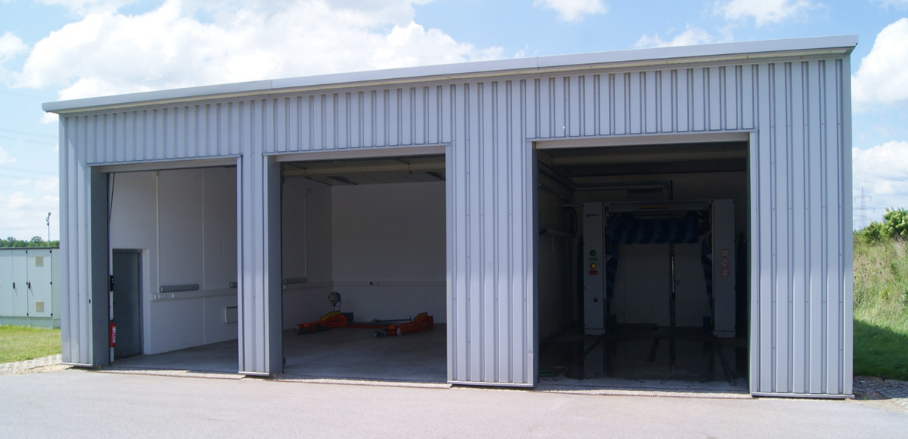
service box and car wash

Slide 25
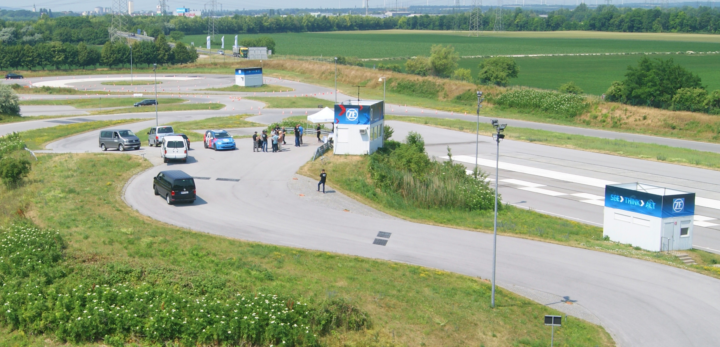
Training rooms with billboards on the track

Slide 26
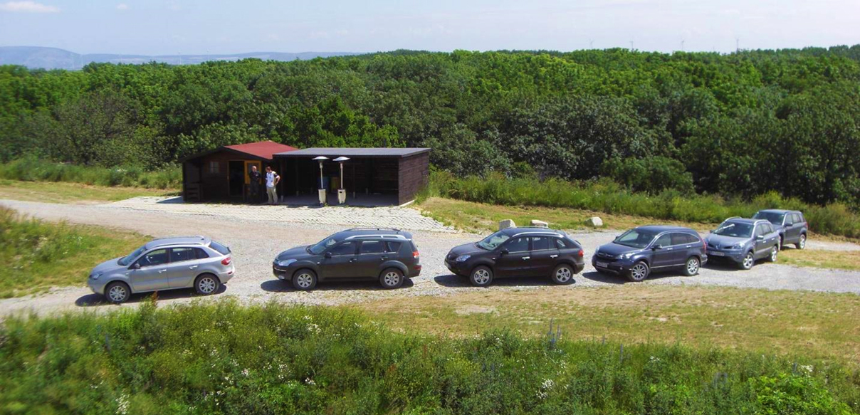
log cabin at off-road area

